Slide 1


Potjamarn Arpornratn
10/17/2025

Slide 2

Outline
Executive Summary
Introduction
Methodology
Results
Conclusion
Appendix

Slide 3
Executive Summary
Summary of methodologies
Summary of all results

Slide 4
Introduction
This report is created to predict if SpaceX Falcon 9 First stage will land successfully. This information will be used to determine the cost of the launch for bidding against SpaceX.
We want to predict whether Falcon 9 First Stage would land successfully so that we can determine the cost of the launch. If Falcon 9 First Stage could be reused, then the cost will be cheaper.

Slide 5

Section 1

Slide 6
Methodology
Executive Summary
Data collection methodology:
Data will be collected (extracted) from multiple sources such as SpaceX APIs, wikipedia, and database
Perform data wrangling
Data wrangling will be performed after the data was collected. We will examine the data: remove NaN, clean, and reformat the data and
Perform exploratory data analysis (EDA) using visualization and SQL
Perform interactive visual analytics using Folium and Plotly Dash
Perform predictive analysis using classification models
Skilearn models (LogisticRegression, SVC, DecisionTree, and KNeighborsClassifier) were used to model the data. GridSearchCV is used for hyperparameter tuning. Then, score() method were used to score each model and performed predictions.

Slide 7
Data Collection
The data were collected from several sources: SpaceX REST API endpoints, past rocket launch data from SpaceX, and webscraping on wikipedia page.
You need to present your data collection process use key phrases and flowcharts

Slide 8
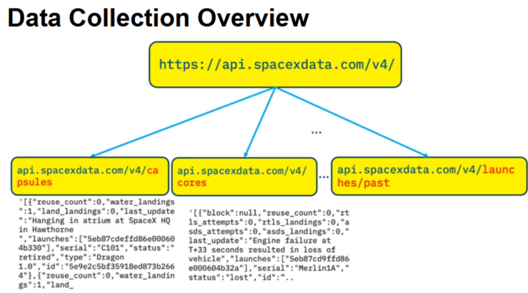
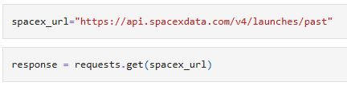
Data Collection – SpaceX API
First set of data was collected using SpaceX REST calls on the past endpoint.
GitHub URL of the completed SpaceX API calls notebook: See jupyter-labs-spacex-data-collection-api.ipynb

Slide 9
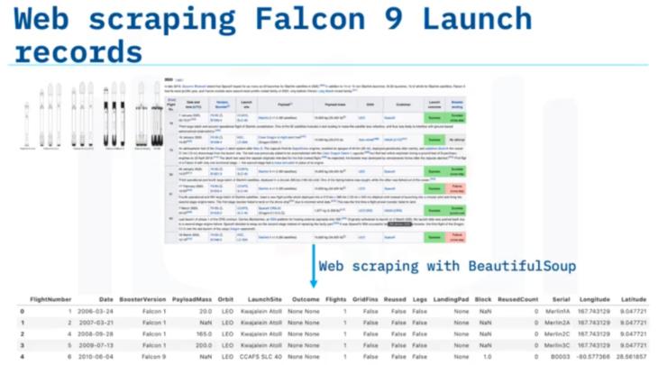
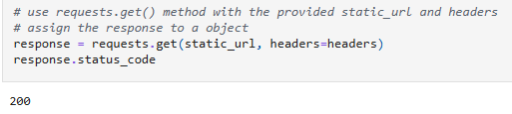

Data Collection - Scraping
Web scraping process started from fetching the data then parsed response data using BeautifulSoup
See "Jupyter Notebook on GitHub URL" (click here) of the completed web scraping notebook, as an external reference and peer-review purpose

Slide 10
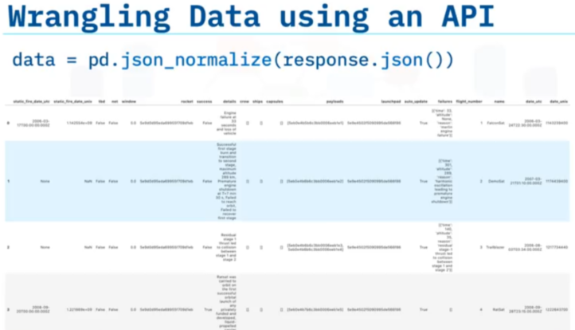
Data Wrangling
The data was cleaned, NaN (if exists) was removed. Numerical and Categorical columns were identified and processed. Landing outcome label were created and assigned to Class column.
Here is GitHub URLof completed data wrangling related notebooks, as an external reference and peer-review purpose.

Slide 11
EDA with Data Visualization
Scatter charts were created for visualization of: FlightNumber vs. PayloadMass, Flight Number and Launch Site, Payload Mass and Launch Site, success rate of each orbit, FlightNumber and Orbit, Payload Mass and Orbit, and launch success yearly trend. After EDA, Feature Engineering was performed on the insights.
See GitHub URL of completed EDA with data visualization notebook, as an external reference and peer-review purpose

Slide 12
EDA with SQL
First, blank rows were removed from the table, then the following SQL queries were performed:
Fetch names of the unique launch sites in the space mission
Fetch records where launch sites begin with the string 'CCA'
Fetch total payload mass carried by boosters launched by NASA (CRS)
Fetch average payload mass carried by booster version F9 v1.1
Fetch the date when the first successful landing outcome in ground pad was achieved.
Fetch a list of the boosters which have success in drone ship and have payload mass greater than 4000 but less than 6000
Fetch total number of successful and failure mission outcomes
Fetch all the booster_versions that have carried the maximum payload mass, using a subquery with a suitable aggregate function.
List the records which will display the month names, failure landing_outcomes in drone ship ,booster versions, launch_site for the months in year 2015.
Rank the count of landing outcomes (such as Failure (drone ship) or Success (ground pad)) between the date 2010-06-04 and 2017-03-20, in descending order.
See GitHub URL of completed EDA with SQL notebook, as an external reference and peer-review purpose

Slide 13
Build an Interactive Map with Folium
All launch sites along with success/failed rate were marked on the map using MarkerCluster, circles, markers, and MousePosition. Then proximity lines were added to the map using PolyLine objects to show the distance between coastline point and launch site.
Folium.Circle is used to add a highlighted circle area with a text label on a specific coordinate. Markers were created and added to the map to show all launch outcomes. If a launch was successful (class=1), then we use a green marker and if a launch was failed, we use a red marker (class=0)
Explain why you added those objects
See GitHub URL (here) of completed interactive map with Folium map, as an external reference and peer-review purpose. Note: use this link to view the interactive notebook: https://nbviewer.org/

Slide 14
Build a Dashboard with Plotly Dash
Interactive Dashboard was built using Plotly Dash with the following functionality:
Launch Site drop-down (with pre-populated launch sites) and Callback functions to render pie chart for selected option. Pie chart displays successful launches by Site (if All Site option is selected) or success launches per selected site.
Range Slider for selected Payload
Callback function to render Scatter plot for selected launch site displays successful mission related to selected Slider Payload.
See GitHub URL of your completed Plotly Dash lab, as an external reference and peer-review purpose

Slide 15
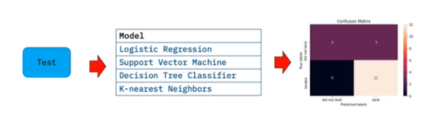
Predictive Analysis (Classification)
Machine learning pipeline was built using different models such as: Logistic Regression, Support Vector machines, Decision Tree Classifier, and K-nearest neighbors. The models were evaluated, then hyperparameters tuned using GridSearchCV. Accuracy score and confusion matrix were generated for each model.
** Test score and accuracy (model.best_score_) score were captured for comparison.
See GitHub URL of your completed predictive analysis lab, as an external reference and peer-review purpose

Slide 16
Results
Exploratory data analysis results
Interactive analytics demo in screenshots
Predictive analysis results

Slide 17

Section 2

Slide 18
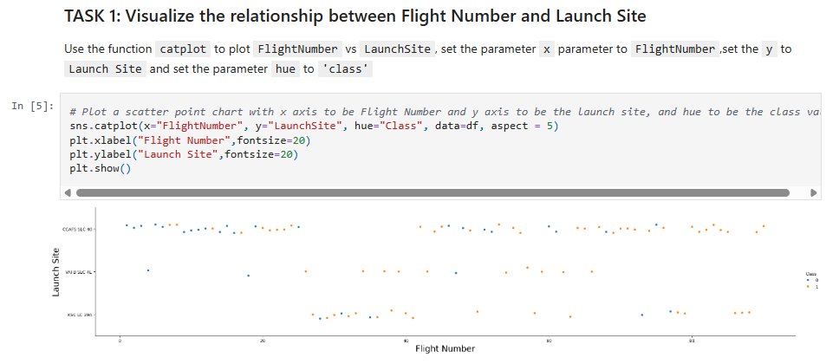
Flight Number vs. Launch Site
From the scatter plots on the right, you can see that as the flight number increase, the success rate also increase. CCAFS SLC-40 has more success rate than other launch sites when flight number > 80
VAFB SLC-4E site has around 70 flights

Slide 19
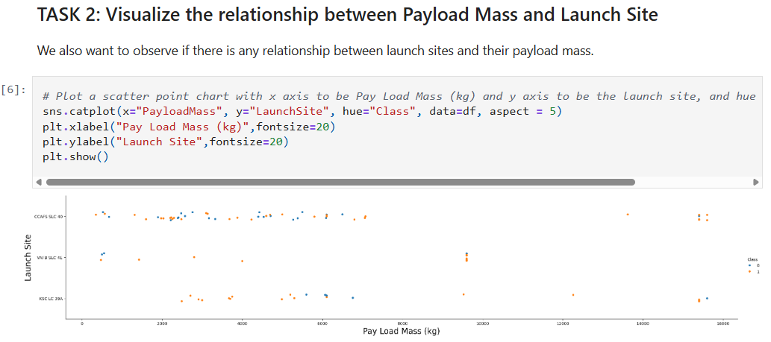
Payload vs. Launch Site
Notice that CCAFS SLC-40 and KSC LC-39A launch sites has success rate with heavy PayloadMass (around 16,000 kgs)
VAFB SLC-4E has no launch for heavy PayloadMass > 10,000 kgs

Slide 20
Success Rate vs. Orbit Type
Show a bar chart for the success rate of each orbit type
Show the screenshot of the scatter plot with explanations

Slide 21
Flight Number vs. Orbit Type
Show a scatter point of Flight number vs. Orbit type
Show the screenshot of the scatter plot with explanations

Slide 22
Payload vs. Orbit Type
Show a scatter point of payload vs. orbit type
Show the screenshot of the scatter plot with explanations

Slide 23
Launch Success Yearly Trend
Show a line chart of yearly average success rate
Show the screenshot of the scatter plot with explanations

Slide 24
All Launch Site Names
Find the names of the unique launch sites
Present your query result with a short explanation here

Slide 25
Launch Site Names Begin with 'CCA'
Find 5 records where launch sites begin with `CCA`
Present your query result with a short explanation here

Slide 26
Total Payload Mass
Calculate the total payload carried by boosters from NASA
Present your query result with a short explanation here

Slide 27
Average Payload Mass by F9 v1.1
Calculate the average payload mass carried by booster version F9 v1.1
Present your query result with a short explanation here

Slide 28
First Successful Ground Landing Date
Find the dates of the first successful landing outcome on ground pad
Present your query result with a short explanation here

Slide 29
Successful Drone Ship Landing with Payload between 4000 and 6000
List the names of boosters which have successfully landed on drone ship and had payload mass greater than 4000 but less than 6000
Present your query result with a short explanation here

Slide 30
Total Number of Successful and Failure Mission Outcomes
Calculate the total number of successful and failure mission outcomes
Present your query result with a short explanation here

Slide 31
Boosters Carried Maximum Payload
List the names of the booster which have carried the maximum payload mass
Present your query result with a short explanation here

Slide 32
2015 Launch Records
List the failed landing_outcomes in drone ship, their booster versions, and launch site names for in year 2015
Present your query result with a short explanation here

Slide 33
Rank Landing Outcomes Between 2010-06-04 and 2017-03-20
Rank the count of landing outcomes (such as Failure (drone ship) or Success (ground pad)) between the date 2010-06-04 and 2017-03-20, in descending order
Present your query result with a short explanation here

Slide 34

Section 3

Slide 35
<Folium Map Screenshot 1>
Replace <Folium map screenshot 1> title with an appropriate title
Explore the generated folium map and make a proper screenshot to include all launch sites’ location markers on a global map
Explain the important elements and findings on the screenshot

Slide 36
<Folium Map Screenshot 2>
Replace <Folium map screenshot 2> title with an appropriate title
Explore the folium map and make a proper screenshot to show the color-labeled launch outcomes on the map
Explain the important elements and findings on the screenshot

Slide 37
<Folium Map Screenshot 3>
Replace <Folium map screenshot 3> title with an appropriate title
Explore the generated folium map and show the screenshot of a selected launch site to its proximities such as railway, highway, coastline, with distance calculated and displayed
Explain the important elements and findings on the screenshot

Slide 38

Section 4

Slide 39
<Dashboard Screenshot 1>
Replace <Dashboard screenshot 1> title with an appropriate title
Show the screenshot of launch success count for all sites, in a piechart
Explain the important elements and findings on the screenshot

Slide 40
<Dashboard Screenshot 2>
Replace <Dashboard screenshot 2> title with an appropriate title
Show the screenshot of the piechart for the launch site with highest launch success ratio
Explain the important elements and findings on the screenshot

Slide 41
<Dashboard Screenshot 3>
Replace <Dashboard screenshot 3> title with an appropriate title
Show screenshots of Payload vs. Launch Outcome scatter plot for all sites, with different payload selected in the range slider
Explain the important elements and findings on the screenshot, such as which payload range or booster version have the largest success rate, etc.

Slide 42

Section 5

Slide 43
Classification Accuracy
Visualize the built model accuracy for all built classification models, in a bar chart
Find which model has the highest classification accuracy

Slide 44
Confusion Matrix
Show the confusion matrix of the best performing model with an explanation

Slide 45
Conclusions
Point 1
Point 2
Point 3
Point 4
…

Slide 46
Appendix
Include any relevant assets like Python code snippets, SQL queries, charts, Notebook outputs, or data sets that you may have created during this project

Slide 47


